Slide 1



HomeSpaces
Home
Spaces
By: Paarth Gilhotra
www.homeSpaces.com

Slide 2
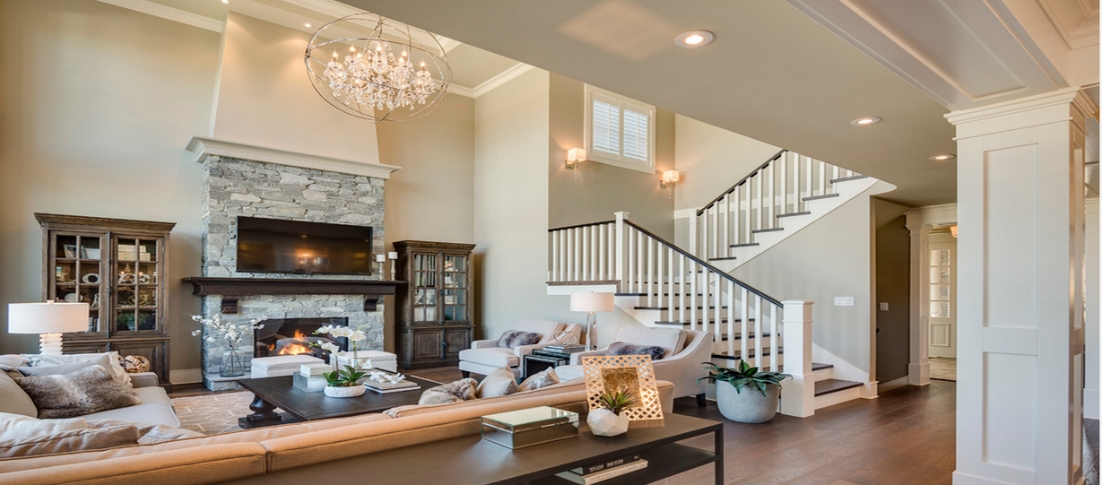
Introduction.
Our platform simplifies the rental process by offering a user-friendly website built with React and powered by Firebase. It enables seamless and secure booking for properties, vehicles, and equipment. Our goal is to make renting easier, faster, and more reliable for both customers and service providers.
www.homespaces.com

Slide 3
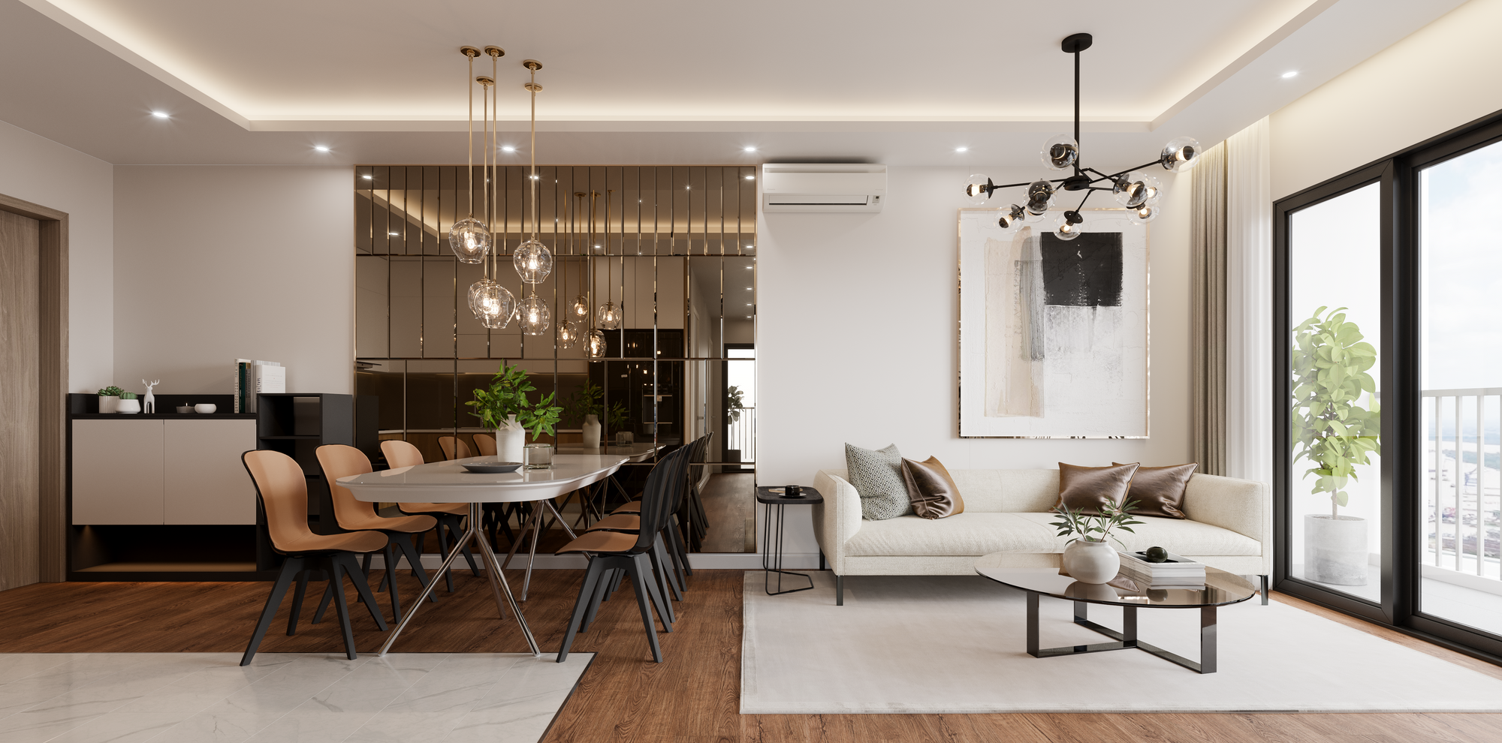
HomeSpaces
AIM.
To develop a user-friendly rental services website using React and Firebase that allows users to easily browse, search, and book rentals, while providing secure authentication and efficient data management.
www.homespaces.com

Slide 4
Our Objectives
Our Vision
Our Mission
To create a seamless, accessible, and reliable platform that revolutionizes the rental experience, empowering users to easily find and book rental services.
To provide a simple, secure, and efficient rental platform that connects users with reliable rental services, ensuring a seamless booking experience.
www.homespaces.com

Slide 5
HomeSpaces
Modules.
ADMIN PANEL
USER PANEL
Login
Manage Category
Manage Exercise
View User
View Request
View Enquiry
Register/Login
View Category
View Exercise
View History and diets
view Profile
Add Enquiry
www.homespace.com

Slide 6
Software Requirements
Operating System
Front-end
Front-end
Framework
Windows OS, Mac OS, Linux
Visual Studio code,
BootStrap
React js
Back-end
Database
Operating System
Firebase
Firebase Cloud
Google Chrome, Mozilla Firefox, Internet Exploral
www.homeSpaces.com

Slide 7
Hardware Requirement
Processor : intel core i3 or Above
RAM : 2GB or More
SSD : 254GB or More
HDD : 512GB or More
www.homespace.com

Slide 8
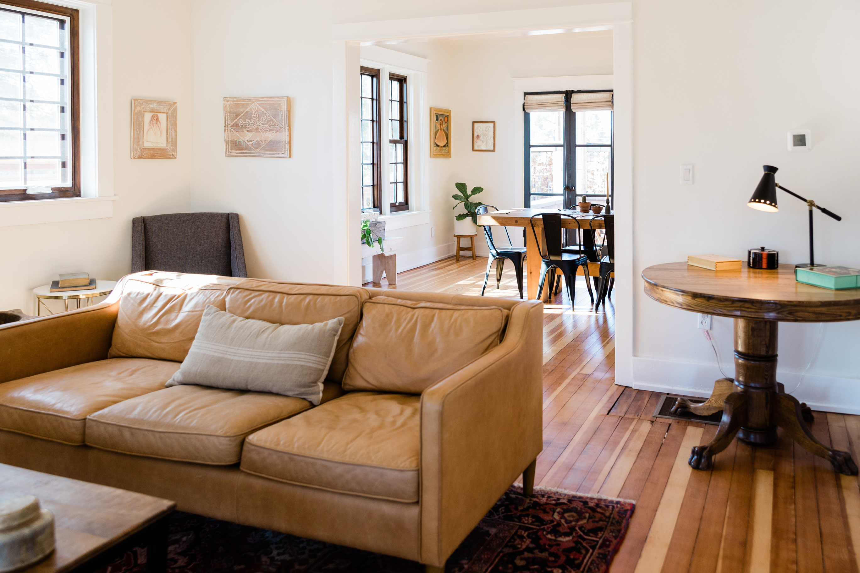
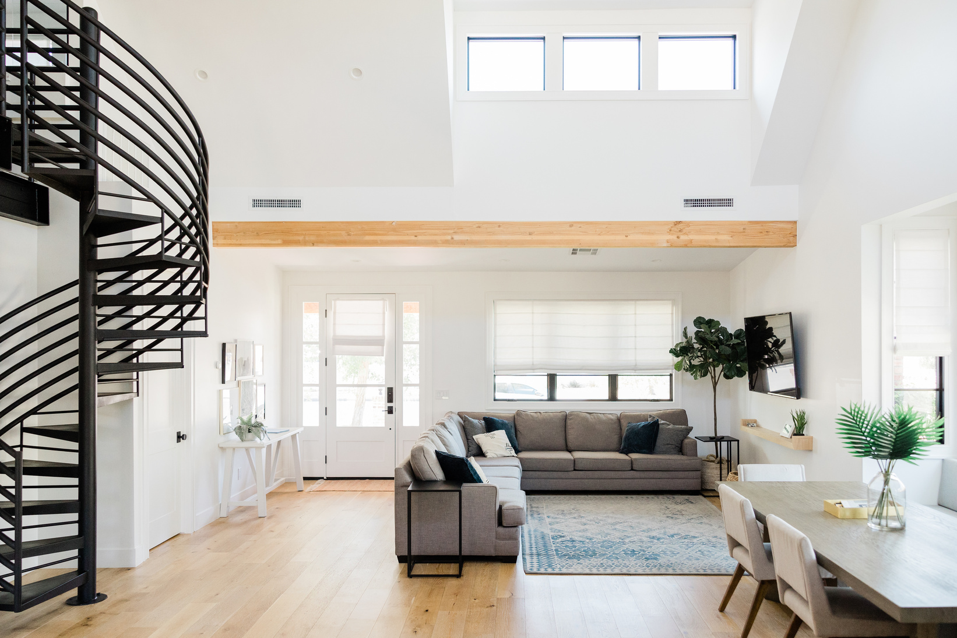
Future Scope.
Advanced Personalization through AI:
Predictive Analytics
Chatbot Assistance
Integration with Wearable Devices:
Real-Time Feedback
Activity Tracking
Multilingual Support:
Localized Content
Global Accessibility
Integration with Virtual Reality (VR) and Augmented Reality (AR):
Virtual Coaching
HomeSpaces

Slide 9
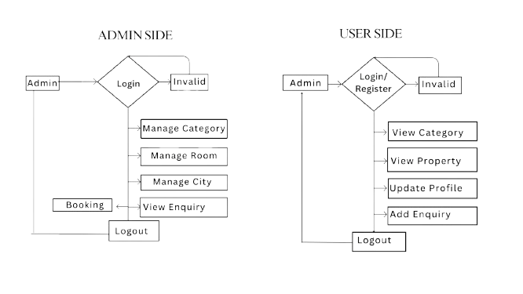
Data Flow Diagram
www.homespaces.com

Slide 10
Thank You...
www.HomeSpaces.com

